Slide 1
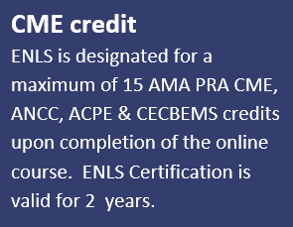
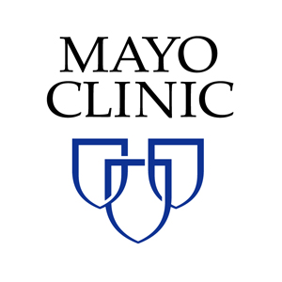
Emergency Neurological Life Support (ENLS)
What to Do in the Critical First Hours of a
Neurological Emergency
Mayo Clinic Cerebrovascular Update & Controversies:
Neurology and Neurosurgery
Thursday, March 22, 2018 || Four Seasons, Las Vegas, NV
Program Overview
ENLS covers a collaborative multi-disciplinary approach that outlines a consistent set of protocols, practical checklists, decision points, and suggested communication to use during patient management.
Topics include: Acute Non-Traumatic Weakness; Acute Ischemic Stroke; Airway, Ventilation and Sedation; Approach to the Comatose Patient; Intracerebral Hemorrhage; Intracranial Hypertension and Herniation; Meningitis and Encephalitis; Pharmacotherapy; Resuscitation Following Cardiac Arrest; Spinal Cord Compression; Status Epilepticus; Subarachnoid Hemorrhage; Traumatic Brain Injury
Course Faculty
W. David Freeman, MD
Kevin Barrett, MD
Alejandro Rabinstein, MD
Bart Demaerschalk, MD
Sarah Peacock, ARNP
Bernard Bendok, MD
Earn CME Credit:
ENLS is designated for a maximum of 15 AMA PRA CME, ANCC, ACPE & CECBEMS credits opon completion of the online course. ENLS Certification is valid for two years.
To learn more
and to register:
ce.mayo.edu/neurology-and-neurologic-surgery

