Slide 1
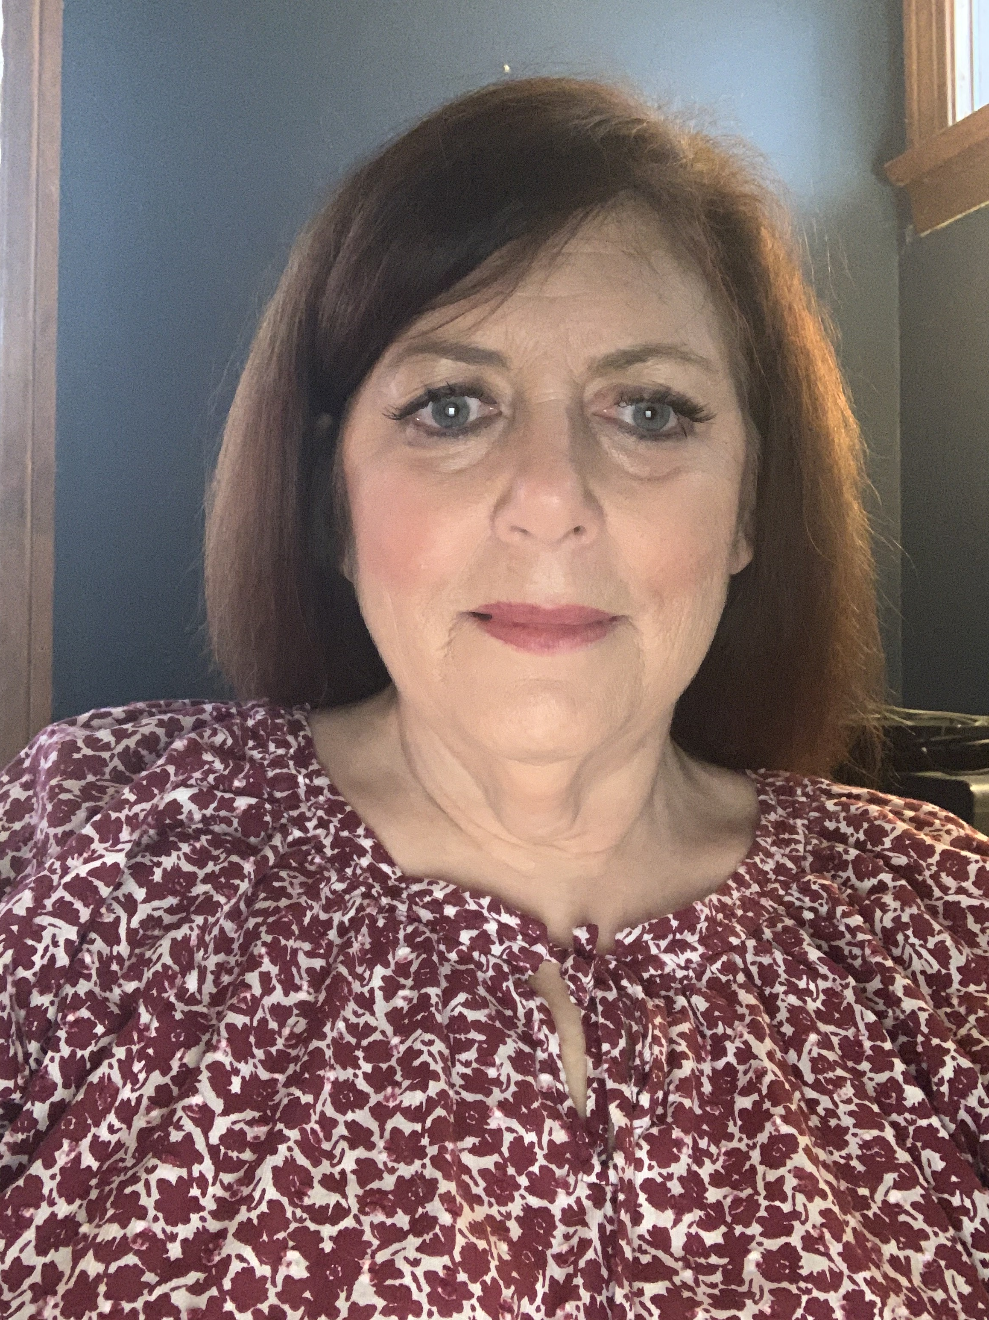
Contact info:
Theo Fouts
843-442-9129
Theo.fouts@sanofi.com
Visit:
mozobil.com/healthcare
(click here or scan the code)
Prescribing Information
(click here or scan the code)
© 2020 sanofi-aventis U.S. LLC. All rights reserved. MAT-US-2019220-v1.0-09/2020

